Slide 1
ABC - Technical Presentation
Date: 26th September 2020
Presenter: Nidhi Kakar

Slide 2
A sharp decline in the no of customers for ABC Retail store from Dec 2010 to Dec 2011, emphasizes the need to target key customers to increase its sales over this period
We see a sharp decline in the no of customers in a year resulting in loss of sales for ABC
Though ABC sells across 37 countries, its sales have started to decline in all resulting in loss of customers
ABC sells 3877 products but the top 10 products account for only 10% of total sales.
We need to encourage customers to engage in cross selling to buy more variety of products which will increase customers stickiness.
Customers are buying maximum in the last quarter owing to seasonal products offered by ABC. Customers might hibernate if we do not encourage them to buy the non-seasonal products alongside.
Seasonality in the purchase pattern of the products has been observed

Slide 3
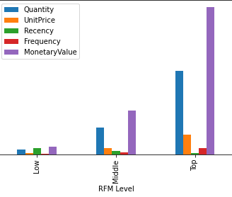
Customers were segmented into three clusters on the basis of their recency frequency and monetary value.
Key Insights
Low segment customers are contributing to only 4% of total sales but account for 30% of total customers.
Middle segment customers are contributing to 22% of the total sales and account for 41% of the total customers.
Top segment customers are the best customers of ABC. They are the loyal customers.
Different set of customers have to be targeted with different objectives and hence different marketing campaigns.
Source: ABC Sales Records 2010-2011 in Euro Currency

Slide 4
Descriptive and Statistical Approach were taken to find out the key factors determining customer segmentation
What opportunities exist for ABC, an online retail store to target its customers efficiently in the coming year
Descriptive Statistics
Inferential Statistics

Slide 5
Data Preparation
Step 1: Missing Value treatment
Step 2: Data Cleaning
Step 3: Final Variables
25% of the customers IDs are missing .
Quantity had negative values.
Unit price had negative values
Out of 37 countries to which ABC sells, UK is the top buyer accounting for 85% of the sales.
Source: ABC Sales Records 2010-2011 in Euro Currency

Slide 6
Inferential Statistics – RFM Analysis
 | mean | mean | mean | count
RFM_Score
3.0 | 288.4 | 8.0 | 157.2 | 369
4.0 | 199.1 | 14.2 | 231.7 | 372
5.0 | 169.5 | 21.4 | 361.8 | 533
6.0 | 118.6 | 28.5 | 652.9 | 490
7.0 | 97.8 | 39.6 | 1246.5 | 423
8.0 | 70.2 | 55.2 | 1044.6 | 460
9.0 | 59.1 | 79.8 | 1480.6 | 422
10.0 | 41.8 | 123.0 | 1987.1 | 439
11.0 | 26.7 | 189.4 | 4592.1 | 429
12.0 | 11.2 | 382.1 | 9425.3 | 401
Key Insights
Recency Frequency Monetary Value
Almost equal distribution of customers in the three segments.
Clear distinction in the three groups in terms of RFM
However, we still need to confirm the clustering through k-means clustering.
 | mean | mean | mean | count
RFM Level
Low | 212.6 | 15.4 | 264.6 | 1274
Middle | 87.3 | 50.0 | 1087.7 | 1795
Top | 27.0 | 227.3 | 5218.2 | 1269
Recency Frequency Monetary Value
Source: ABC Sales Records 2010-2011 in Euro Currency

Slide 7
Inferential Statistics – RFM Analysis
 | RFM Score | Recency | Frequency | Monetary Value | Count | Count %
 |  | Mean | Mean | Mean
RFM Level
Low | 3-5 | 212.6 | 15.4 | 264.6 | 1274 | 29.36%
Middle | 6-9 | 87.3 | 50.0 | 1087.7 | 1795 | 41.37%
Top | 10-12 | 27.0 | 227.3 | 5218.2 | 1269 | 29.25%
Key Insights
Almost equal distribution of customers in the three segments.
Clear distinction in the three groups in terms of RFM
We also have a second approach to segmentation i.e. k-means clustering.

Slide 8
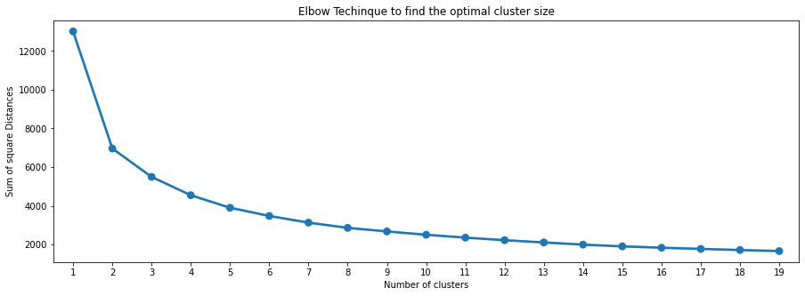
Inferential statistics- k means clustering, Elbow and Silhouette analysis
Key Insights
For n_clusters=2, the silhouette score is 0.3947083072059434
For n_clusters=3, the silhouette score is 0.29057731759393124
For n_clusters=4, the silhouette score is 0.29675439563937894
For n_clusters=5, the silhouette score is 0.2736200368639288
For n_clusters=6, the silhouette score is 0.28258493282306446
For n_clusters=7, the silhouette score is 0.2679503510185217
For n_clusters=8, the silhouette score is 0.2660992277345101
Clusters have been created based on the values of Recency, Frequency and Monetary with the help of K-Means Clustering.
Elbow technique shows any of 3, 4 or 5 can be optimal cluster size.
From silhouette analysis, we can see that both 3 and 4 no of clusters prove to be optimal size.
Further analysis, for 4 clusters represented unclear distinction of customers in the 4 clusters.
Source: ABC Sales Records 2010-2011 in Euro Currency

Slide 9
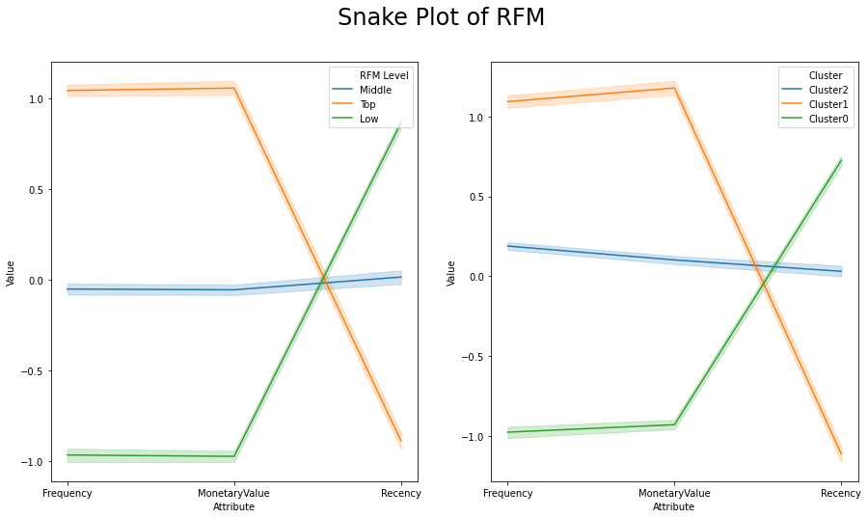
Inferential Statistics – Plotting of clusters through Snake Plot method

Slide 10
Recommendations
TOP Segment | Frequency | Recency | Monetary Value
Mean | 227.29 | 27.03 | 5218.17
min | 20.00 | 1.00 | 360.93
25% | 99.00 | 11.00 | 1546.91
50% | 144.00 | 19.00 | 2479.16
75% | 252.00 | 32.00 | 4199.85
max | 7847.00 | 161.00 | 280206.00
MIDDDLE Segment | Frequency | Recency | Monetary Value
Mean | 50.01 | 87.30 | 1087.74
min | 1.00 | 1.00 | 35.40
25% | 25.00 | 27.50 | 411.65
50% | 40.00 | 62.00 | 673.26
75% | 64.00 | 121.50 | 1078.35
max | 378.00 | 698.00 | 168472.50
LOW Segment | Frequency | Recency | Monetary Value
Mean | 15.43 | 212.60 | 264.55
min | 1.00 | 24.00 | 3.75
25% | 7.00 | 114.00 | 141.52
50% | 12.00 | 202.50 | 221.23
75% | 21.00 | 279.00 | 332.55
max | 96.00 | 698.00 | 1542.08
Middle Segment
Promotional campaigns
Upselling and cross selling of products
Repeat products on discount
Low Segment
Increase user engagement.
Personalized emails.
Discount coupons
Top Segment
New Product Launch.
Source: ABC Sales Records 2010-2011 in Euro Currency

